Slide 1
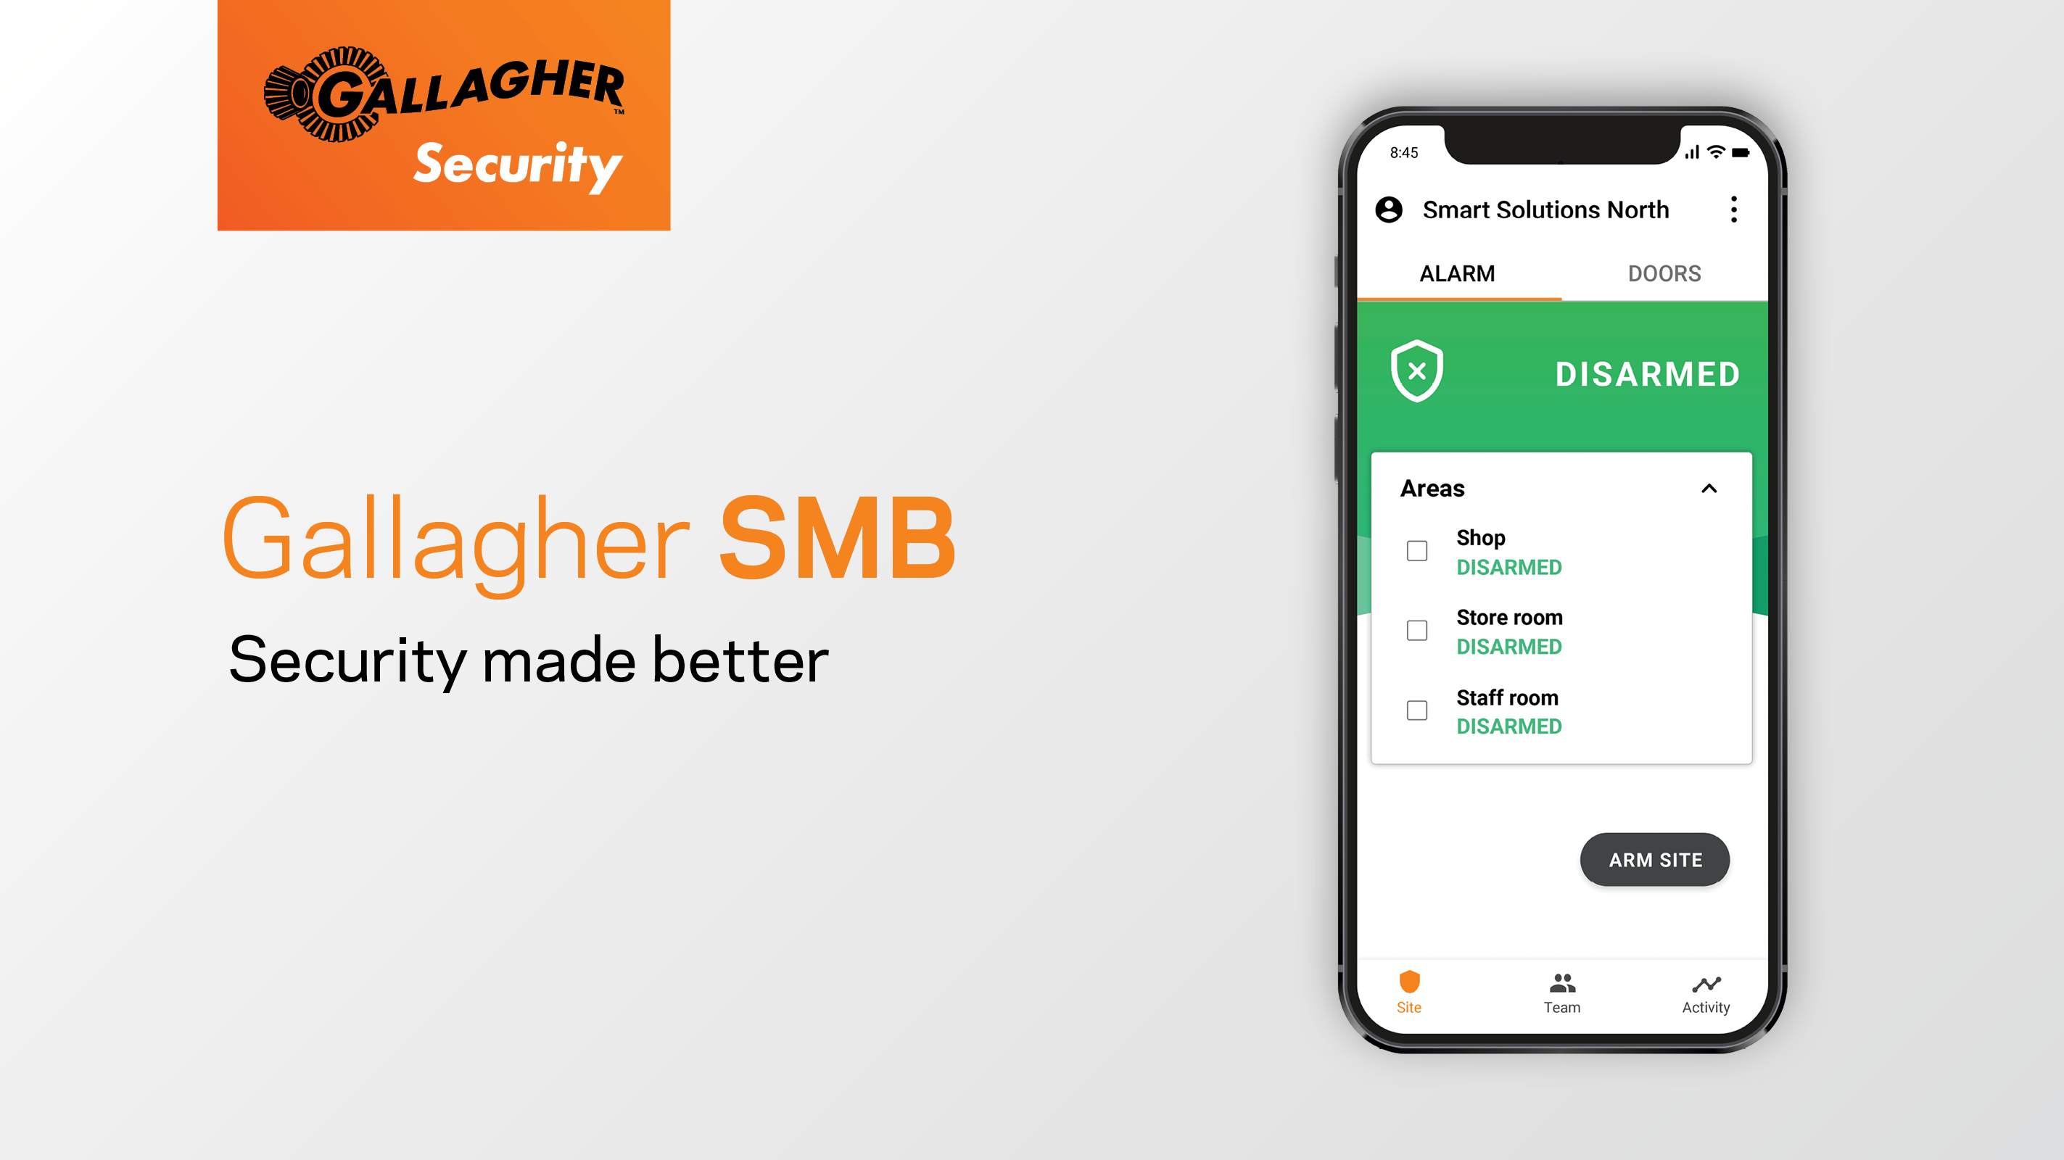
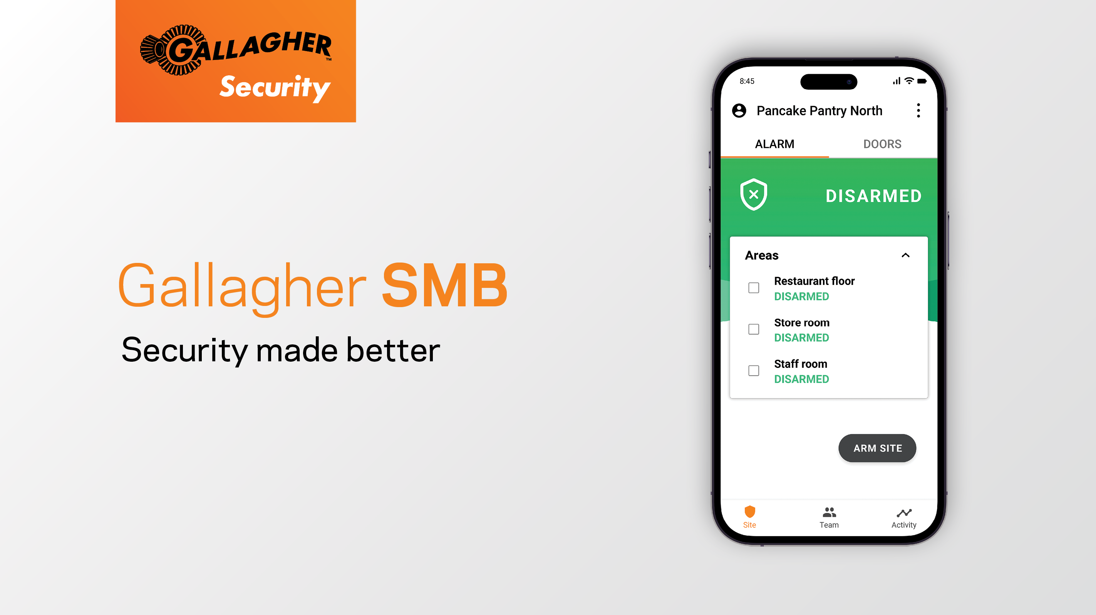

Slide 2
Gallagher SMB (Security Made Better) is a cloud-based solution that brings enterprise-grade access control and intruder detection to small sites – without the complexity. Everything is managed through one simple app.

Slide 3

What does Gallagher SMB offer?
Fully integrated security including intruder detection and access control functionality
Cloud-based security that can be controlled from anywhere you have an internet connection
Protection of multiple sites so you can use one system across them all
Easy to use, intuitive app that reduces the time spent doing every day security tasks
Security that keeps getting better, with new features and functionality frequently added

Slide 4






Gallagher SMB gives your customers complete control of their security, at their fingertips, from one smartphone app.
Intruder detection
Multi-Site
Access control
Self-monitoring
User management
Third-party monitoring
Notes:
Main parts of the solution

Slide 5
Gallagher SMB base functionality

Slide 6
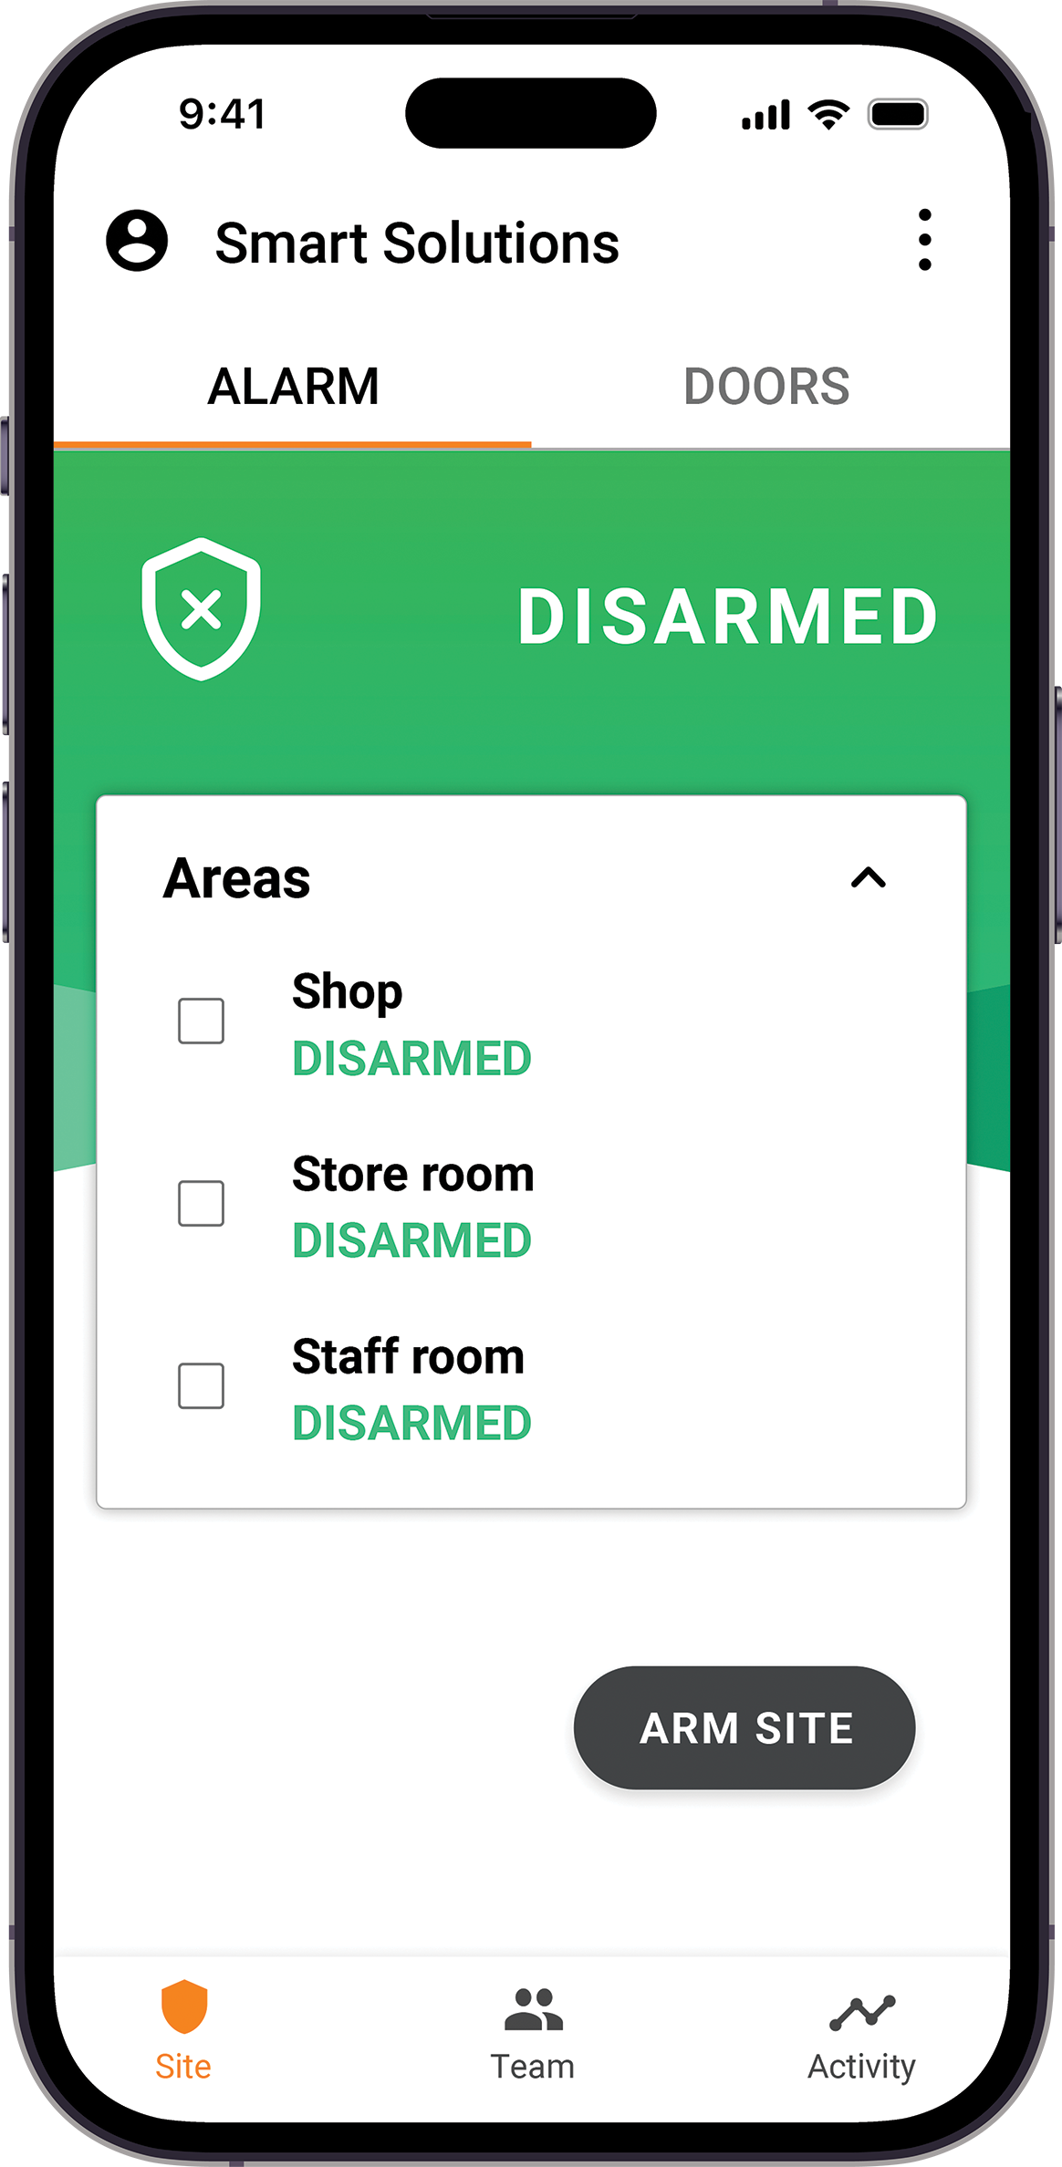
Alarm management
Arm and disarm your way
With Gallagher SMB, managing alarms is easy – whether you’re on-site or on the go.
With SMB, you can:
Arm or disarm locally by tapping your smartphone at a reader
Arm or disarm locally using key tags, access cards, or user codes
Arm or disarm from anywhere using the SMB app
All alarm activity is logged so you always know who armed or disarmed your site, and when.
Secure your site your way – with confidence.

Slide 7
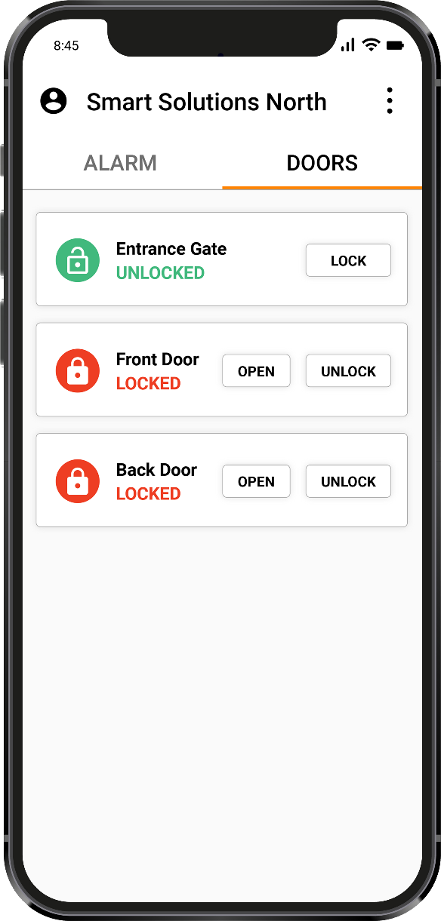
Access control
Control who can go where – and when
Gallagher SMB makes it simple to define who can access specific areas of your site – and when.
With the SMB app, you can:
Set who can access which areas
Control when access is allowed using User Schedules
Instantly update or revoke permissions with a tap
Users can get access using:
Smartphones, key tags or access cards (tapped at a reader)
User codes
Every access event is logged so you always know who was where, and when.
From office doors to restricted zones – access is always in your control.

Slide 8
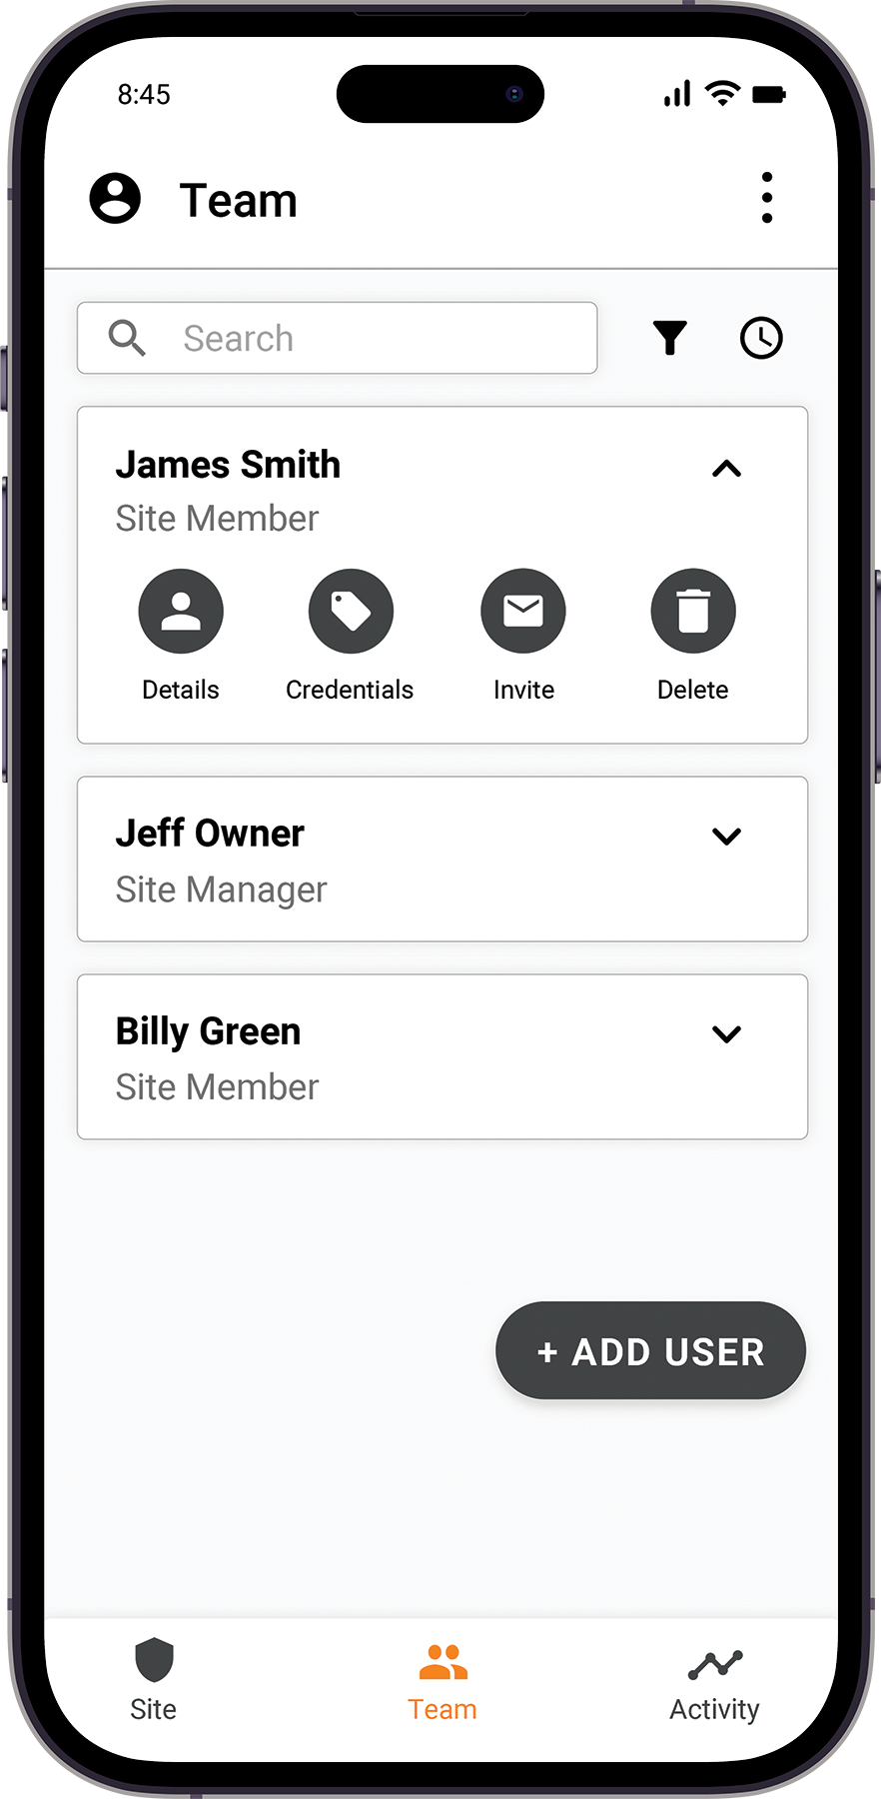
User management
Easily manage users, at any scale
With Gallagher SMB, adding or updating users is quick and intuitive, and no technician is required.
With the SMB app, you can:
Add, edit, or remove users in seconds
Create unlimited users at no extra cost
Assign roles with different permission levels
You can also:
Instantly assign credentials – key tags, cards, or user codes
Give users different roles and access types across multiple sites
Perfect for teams that change, grow, or move often.

Slide 9
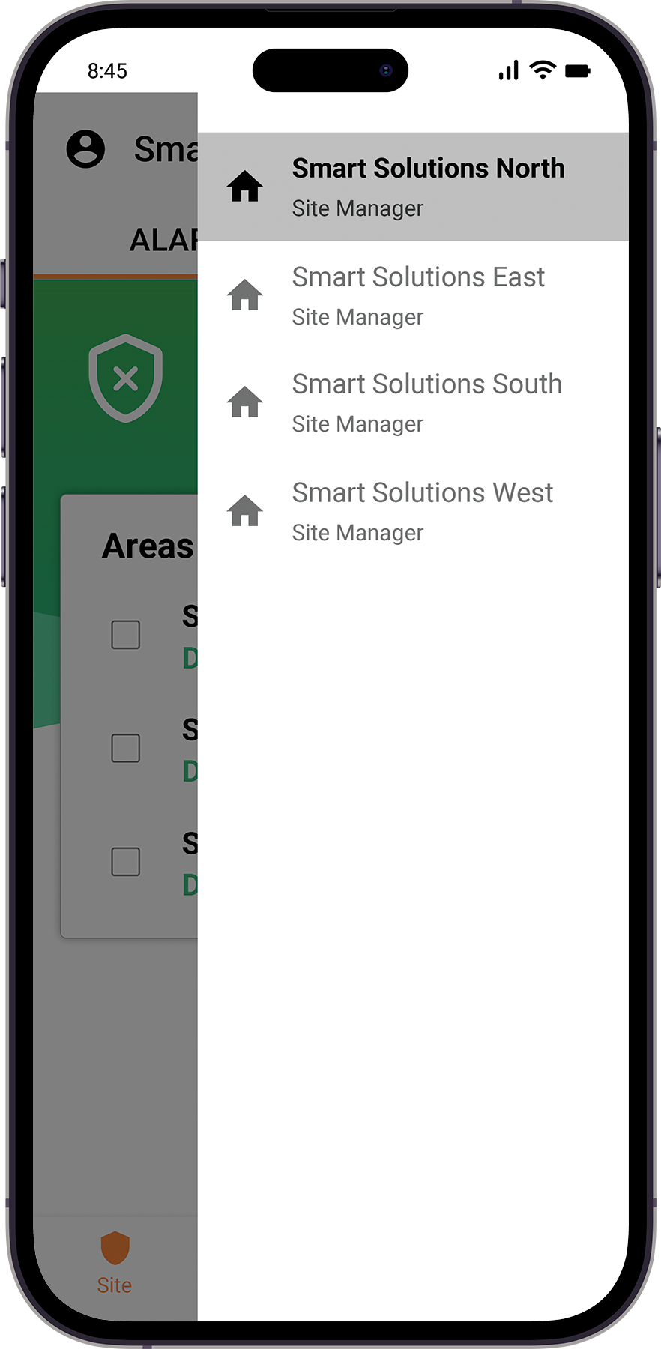
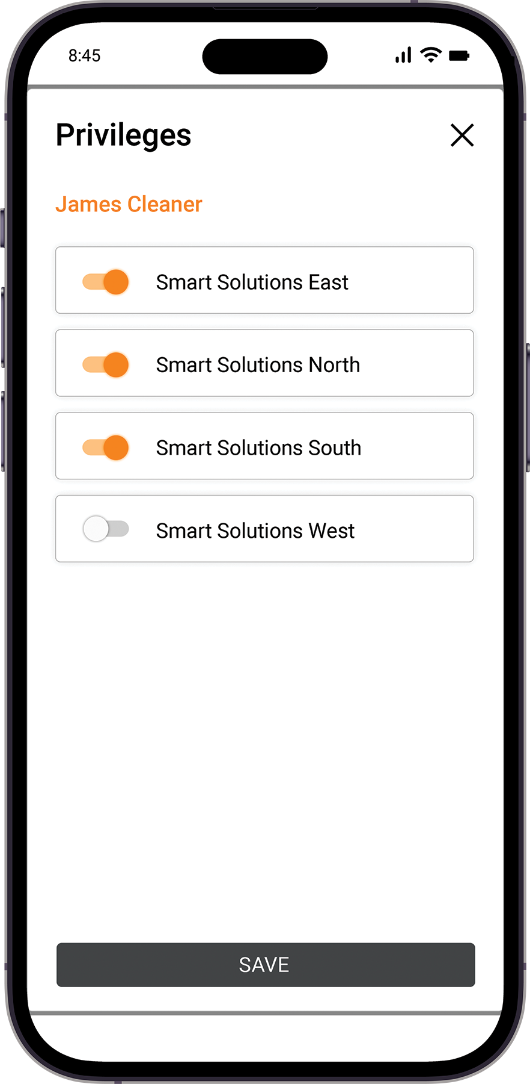
Multi-site management
Manage all your sites from one app
Gallagher SMB makes it easy to secure and control multiple locations – no matter where they are.
With the SMB app, you can:
Manage an unlimited number of sites
Assign user access to multiple sites from one screen
Revoke user access across all sites instantly
Centralized control makes things simple:
Add or update users once, and apply changes to every site
Easily manage staff who work across multiple locations
Ideal for retail chains, franchises, and distributed teams.

Slide 10
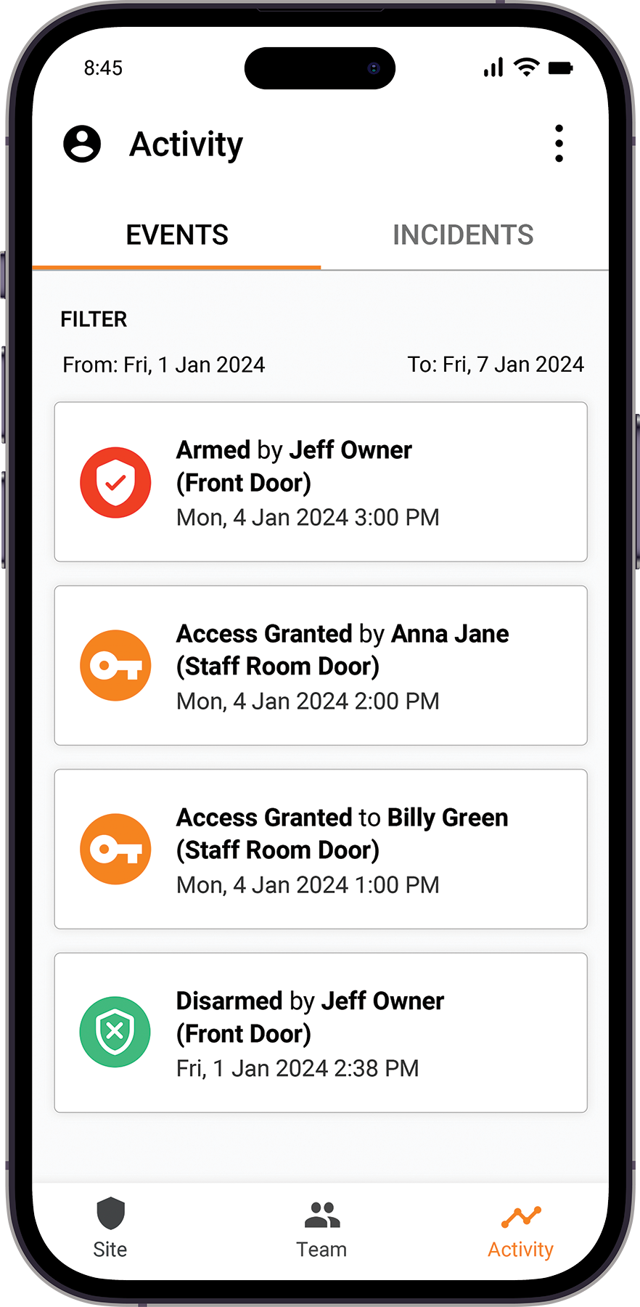
Activity log
Know what's happened – and who was involved
Gallagher SMB gives you full visibility into site activity, so nothing goes unnoticed.
Two tabs in the SMB app help you stay informed:
Events tab
Shows everything that’s happened on-site – and who did it
Filter by action type or date
Export as CSV for reporting
Incident tab
Displays a detailed history of alarm activations
Helps you review and respond to past incidents.
Whether it’s access events or alarm incidents, track and report with confidence,

Slide 11
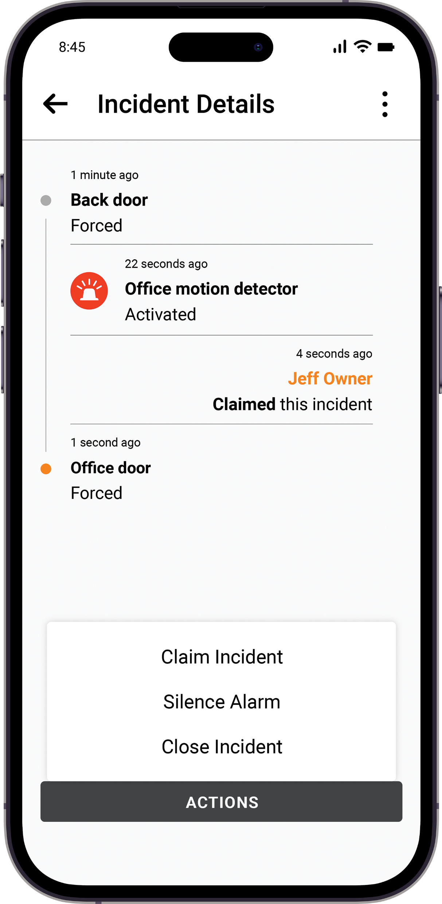
Monitoring
Choose how alarms are managed
Gallagher SMB offers flexible monitoring options putting you in control of how alarm events are handled.
Self-monitored
Site Managers are notified when an alarm is triggered
They can view, claim, silence, and close incidents in the SMB app
Ideal for teams that want full control over alarm response
Third-party monitored
Alarms are routed to a monitoring company
They contact the right people based on your action plan
Use one, the other or both. You’re in control of your alarm event response

Slide 12
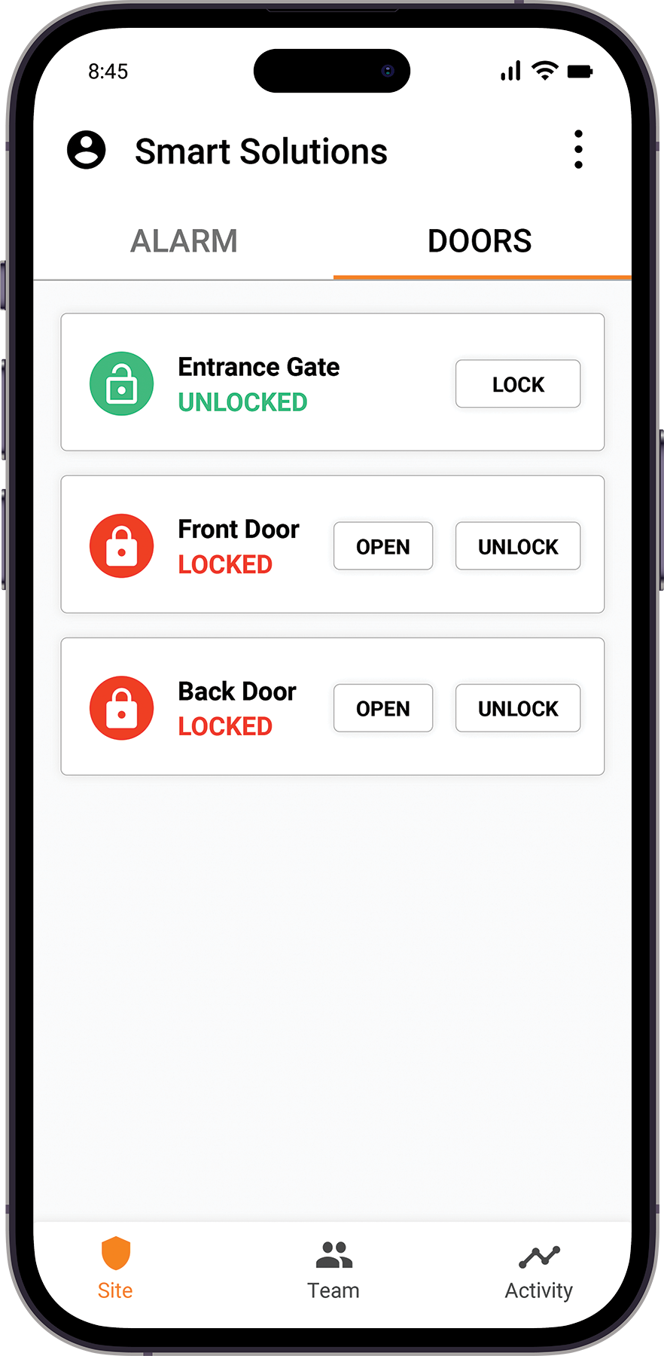
Remote control
Security control – from anywhere
With Gallagher SMB, you can manage your site wherever you are.
Using the SMB app, you can remotely:
Arm or disarm the alarm or individual areas
Lock or unlock doors, gates, and roller doors
Momentarily unlock entry points for deliveries or visitors
Request a security guard (in supported regions)
View alarm notifications and respond in real time
If you’ve got your phone, you’ve got control.

Slide 13
Gallagher SMB feature releases

Slide 14
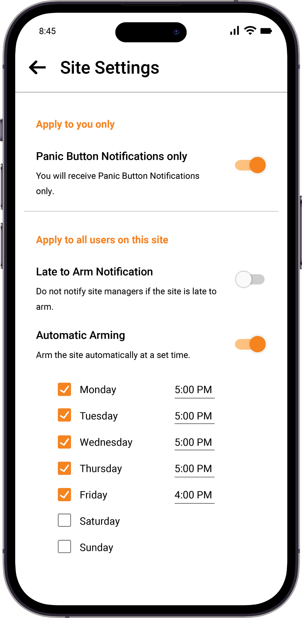
Auto-arming
Never forget to secure your site
With Gallagher SMB, your alarm can arm itself automatically – on your schedule
With the SMB app, you can:
Set your alarm to automatically arm on specific days and at specific times
Ensure your site is secured even if someone forgets to arm it
Pair with Late-to-arm notifications for added peace of mind
Automation that brings confidence and consistency.

Slide 15
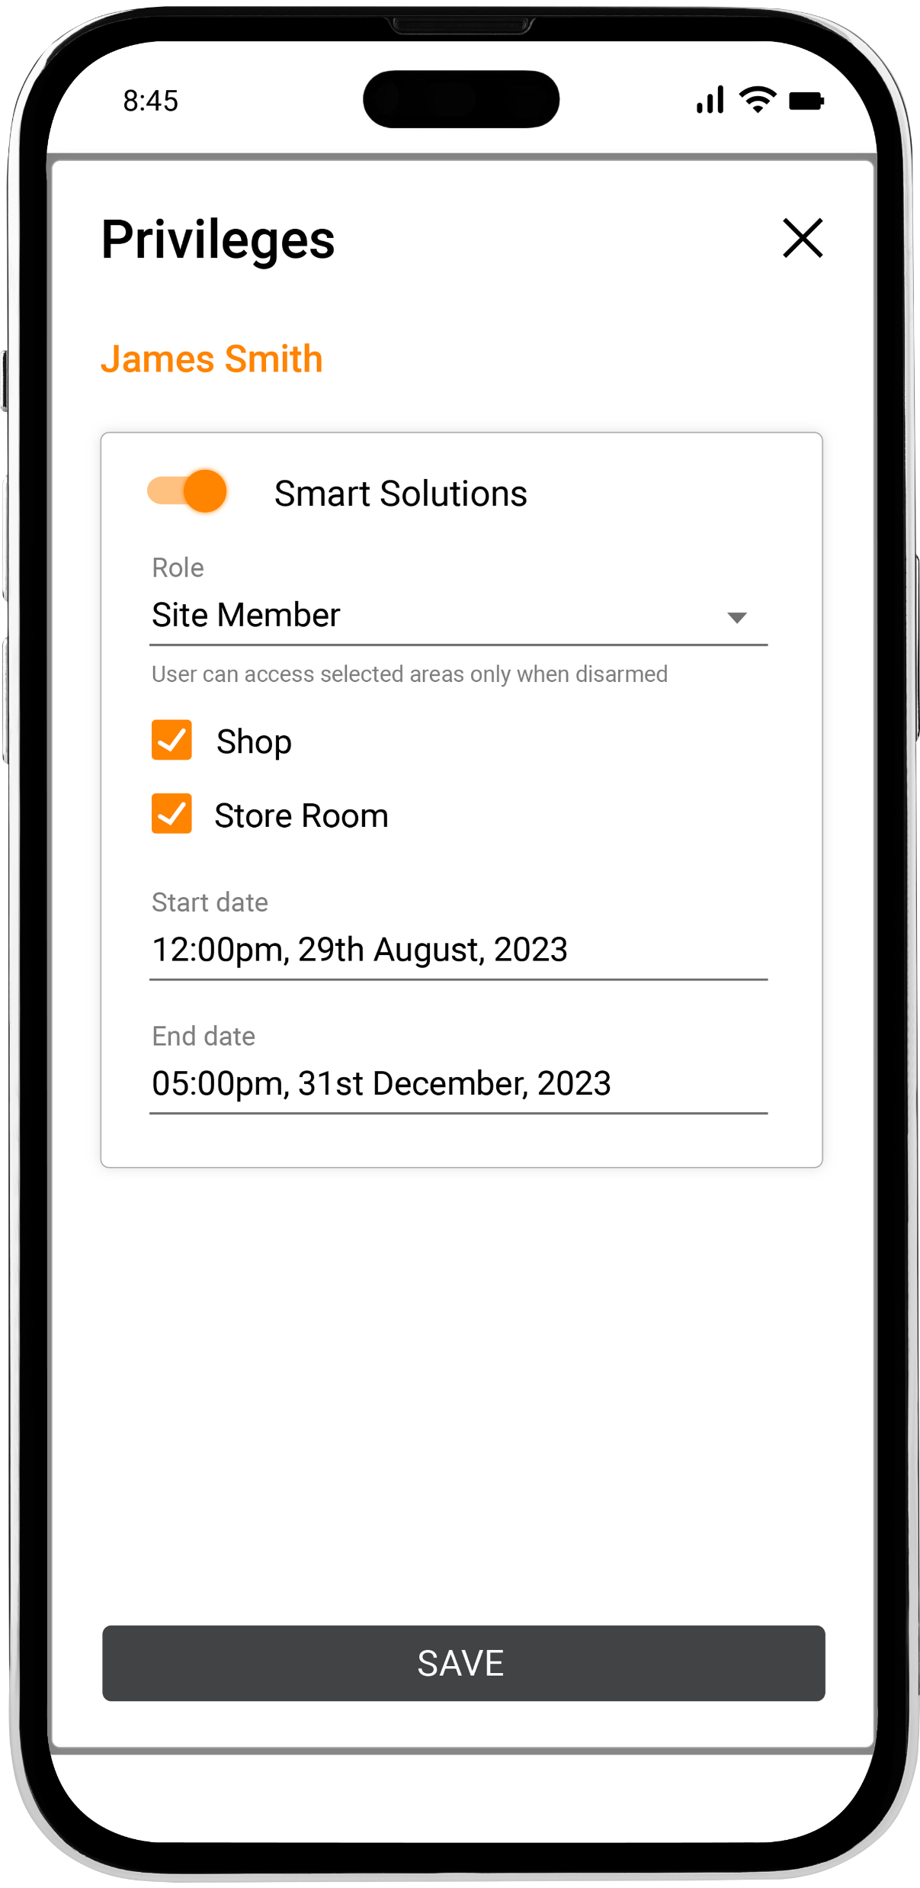
Temporary Users
Easily grant short-term access
Gallagher SMB makes it simple to grant people temporary access
With the SMB app, you can:
Set a commencement and expiry date for any user
Automatically revoke access when the timeframe ends
Perfect for cleaners, contractors, or short-term visitors.

Slide 16
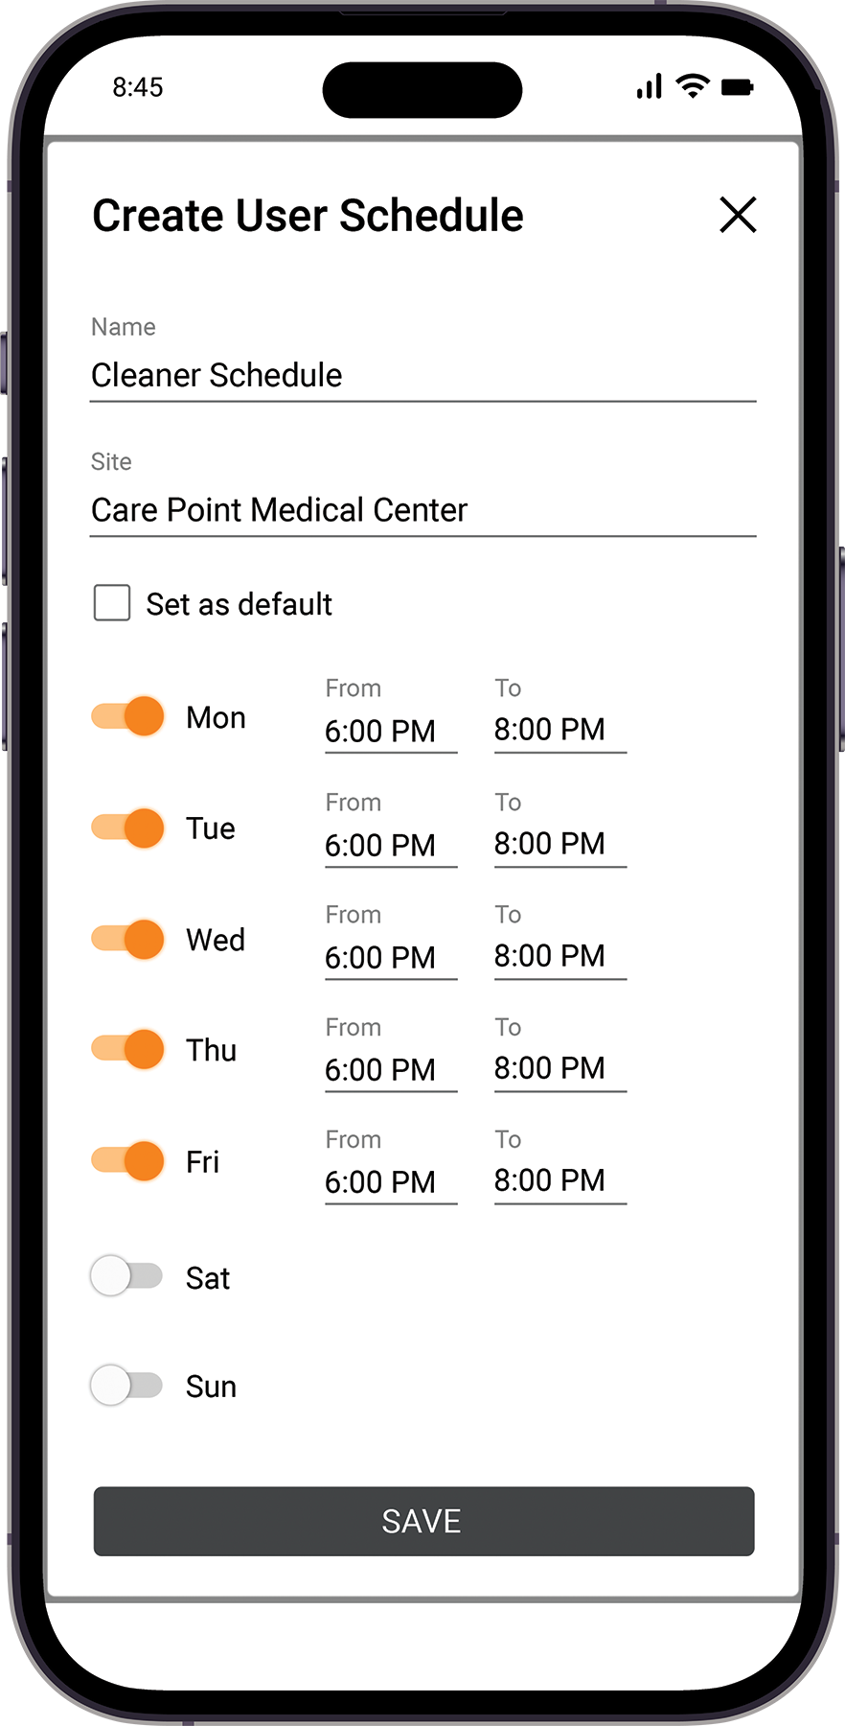
User Schedules
Control when your site can be accessed
With Gallagher SMB you can define access windows based on days and times to match your business needs.
With the SMB app, you can:
Create custom schedules for when access is allowed
Assign them to individual users
Limit access to exactly when it’s needed
Perfect for after-hours staff (such as cleaners), delivery drivers, or rotating shifts

Slide 17
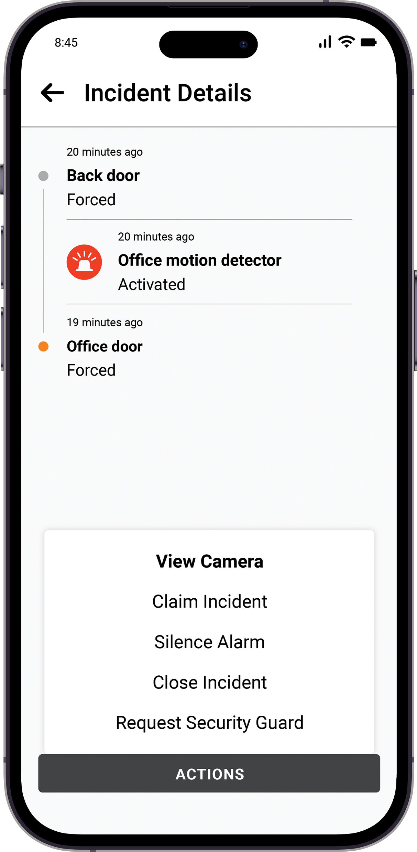
Video Linking
See what’s happening – before you act
Link Gallagher SMB to your existing VMS to visually confirm alarms in real time.
When an alarm is triggered, you can:
Open your existing video camera app directly from the SMB app
Instantly review the footage to verify the alarm
Make more informed, confident decisions – faster
Turn alerts into action, with eyes on-site from anywhere.

Slide 18
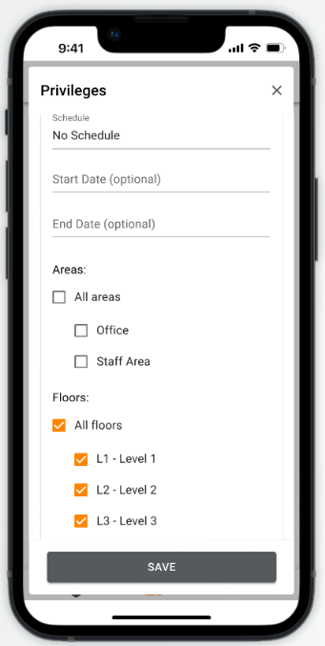
Elevator Control
Secure access to specific floors
Control who can access which floors of your building – right from the SMB app.
With Elevator Control, you can:
Enable or disable lift call buttons
Assign floor access based on user roles in minutes
Use your existing credentials to gain elevator access
Simple, secure multi-floor access. No third-party hardware or software required.

Slide 19
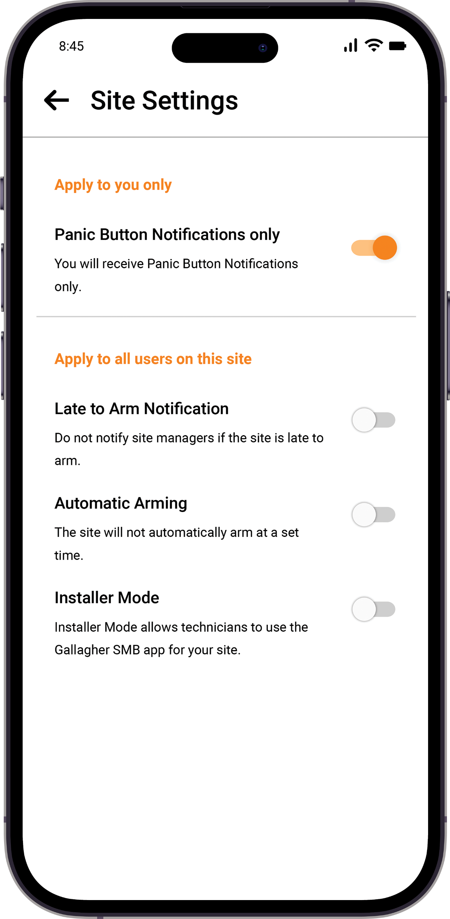
Panic Notifications
Only get notified when it matters most
Gallagher SMB gives you the option to receive notifications only when a panic button is pressed – nothing else.
With Panic Notifications, you can:
Receive alerts only for panic alarm activations
Avoid unnecessary notifications from general system activity
Stay focused on what matters most during critical events
Ideal for business owners and decision makers managing multiple sites – so no important alert is ever missed.

Slide 20
Local Control (Offline Mode)
Stay in control – even without internet
Gallagher SMB’s Offline Mode lets you manage your site using Bluetooth when your system can’t connect to the internet.
With Offline Mode, you can still
Arm or disarm your site using the SMB app
Unlock doors and gain access as normal
Use key tags, cards and user codes without interruption
Peace of mind that your site stays secure – no matter your site’s network status.

Slide 21
Gallagher SMB Installer Portal feature releases

Slide 22
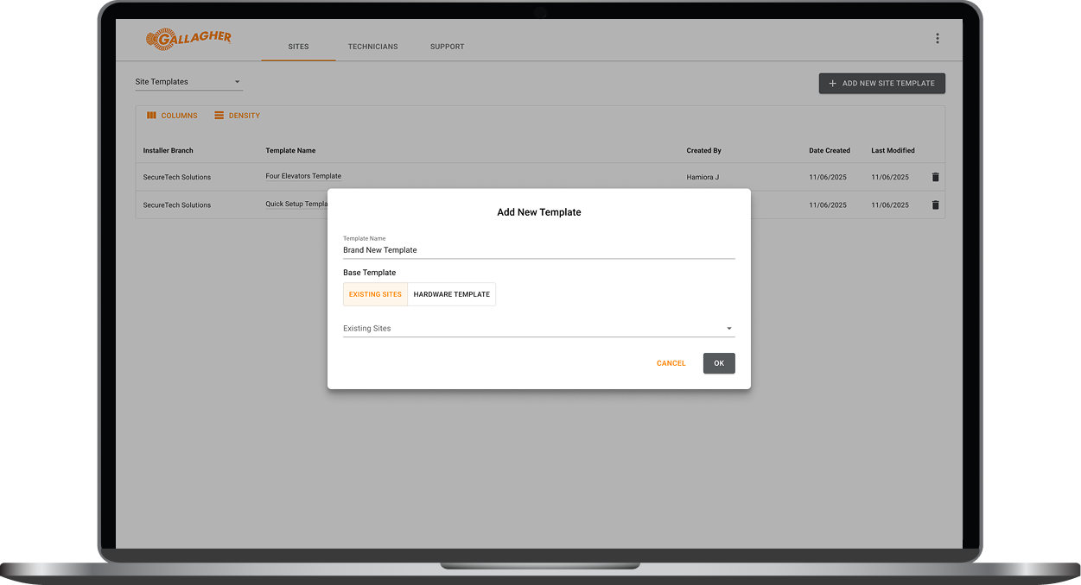
Site Templates
Faster installs. Consistent setups.
Site Templates help your installer get you up and running faster – especially across multi-site SMB deployments.
Here’s how they benefit you:
Faster installs at every new site
Consistent naming, schedules, and setup
Fewer manual errors and misconfigurations
Easier to your setup across multiple sites
Ideal for franchises or chain businesses with repeatable layouts.

Slide 23
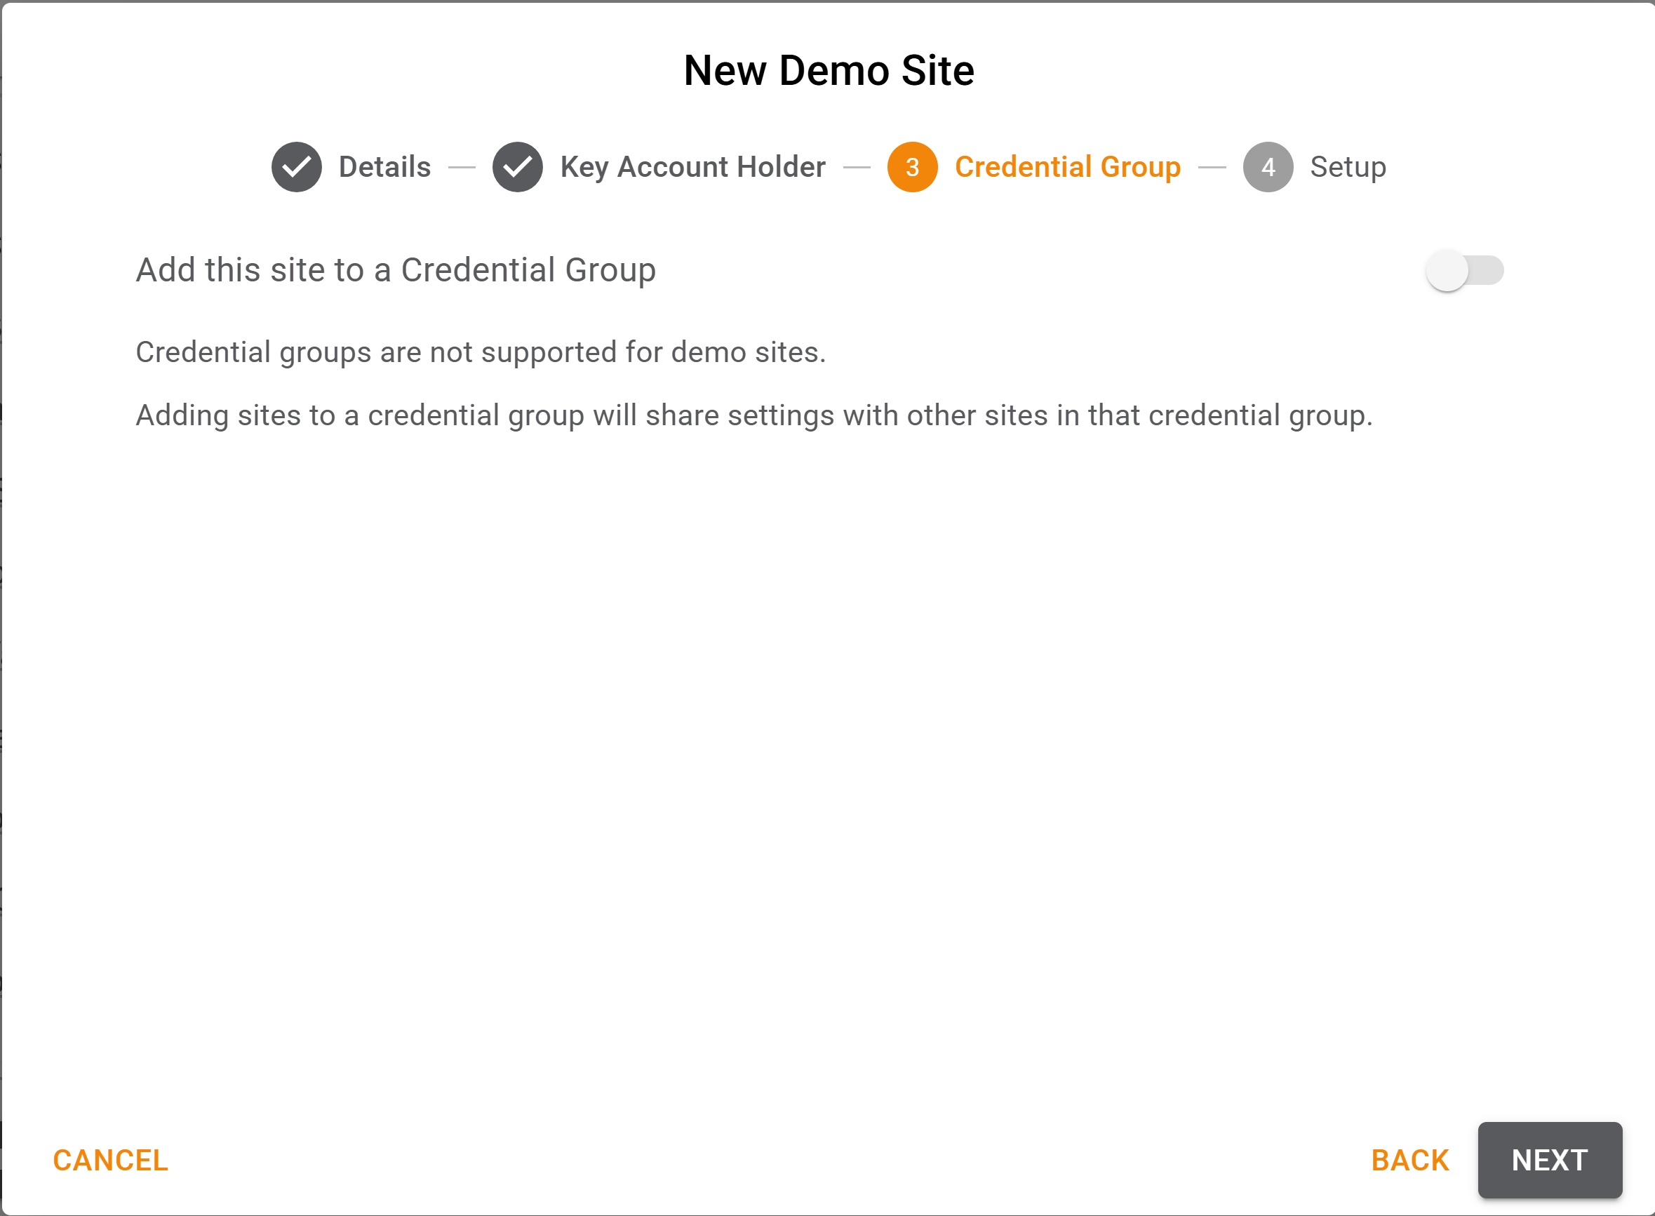
Credential Groups
One credential. Multiple sites.
Simplify access for staff who move between locations.
With Credential Groups, you can:
Grant access to multiple sites with one key tag or user code
Edit or revoke credentials across grouped sites
Avoid re-enrolling users at each location
Great for regional managers, roaming staff, or multi-site teams.

